Slide 1
Fact Or Fake
A Fake News Detection Classifier

Slide 2
Problem Statement
Some Images of fake webites
Fake news snippets
Little funny intro

Slide 3
Data Set
Kaggle column snippets
What all columns : small explanation
Stats table: number of rows, number of fact & fake
length of article
Charts

Slide 4
Experiment Setup
Why NLP?
Preprocessing steps: stemming…..negation handling
Stratified Sampling

Slide 5
Model Features

Slide 6
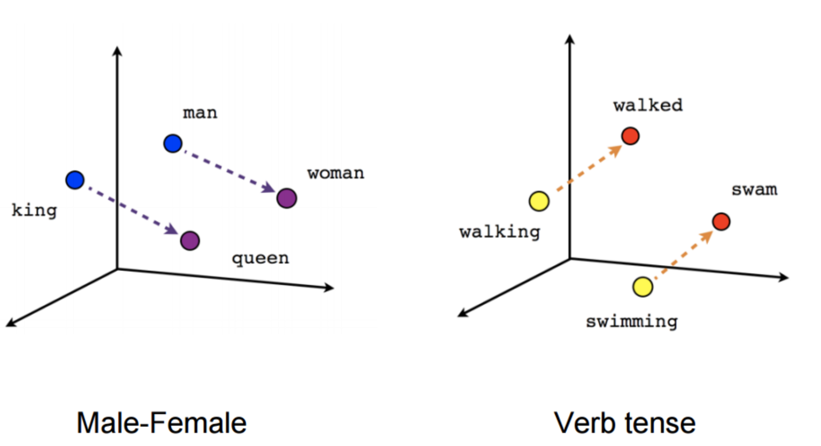
Word2Vec
2 Layered Neural Network to create Word Embeddings
Understands the context to group words
Variants
Continuous Bag Of Words: Context -> Target word
Skip Gram Model: Target Word -> Context

Slide 7
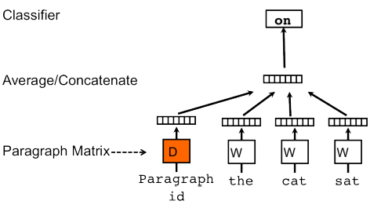
Doc2Vec
Created a fixed Length vector of length 300 for Body And Headline
The paragraph vector and word vectors are averaged to predict next word in context.
PV – DM Distributed Memory Version of Paragraph Vector

Slide 8
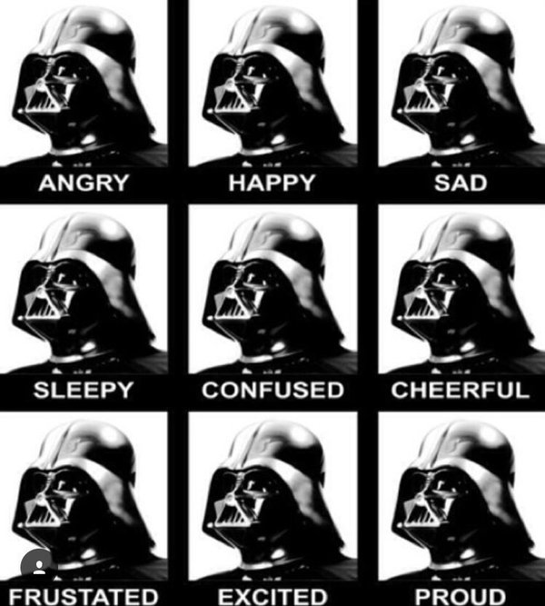
Sentiment Analysis
NLTK Vader – (Valence Aware Dictionary and Sentiment Reasoner)
“The book was kind of good.” Compound: 0.3832, neg: 0.0, neu: 0.657, pos: 0.343

Slide 9
URL Matching
Compiled list of authentic and fake websites
String Matching with Training Data URL
Assigned score based on closeness with fake or real websites
Real Fake www.bbc.com www.bbcn.com

Slide 10
Classifiers
SVM
Parameter tuning – grid search
Accuracy – kernel, C value
Cross validation - 5fold

Slide 11
Decision Tree
Parameters
Accuracy

Slide 12
Naïve Bayes

Slide 13
Deep Learning
Dense Network 1 hidden layer
Accuracy

Slide 14
Ensemble - Accuracy

Slide 15
Conclusion
We found that Deep Learning gives the best accuracy. And ensemble.
Future scope : Fact Check
Don’t trust any article on face value.
Check with us first.

